Slide 1
Waste Pile Sorting
By: Varun Walimbe

Slide 2
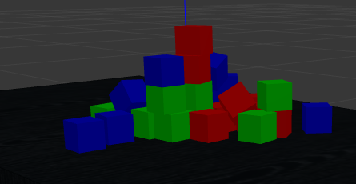
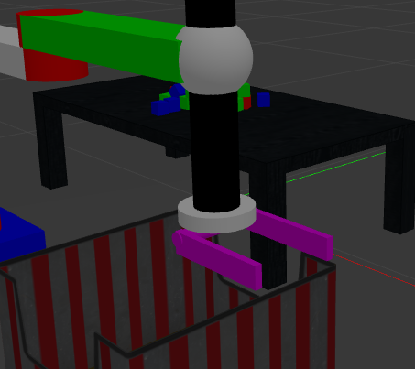
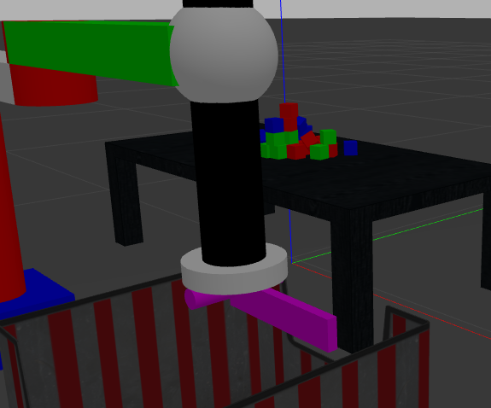
Research Question
-Which gripper will work the best in flattening the pile of boxes in the minimum amount of time?
Pile of Objects
Gripper with Cage
Gripper without cage

Slide 3

Experiment
The following Experiment is performed for evaluating the performance of the grippers:
- Experiment : Robot has to flatten the pile in the minimum possible amount of time. This whole experiment is implemented in Gazebo simulation and robot is controlled using ROS.

Slide 4

Evaluation Metrics
1.Execution time for sorting:Time taken by the robot to complete the task from its sorting location.
2.Success of sorting:Whether the task is successful or not
3.Accuracy of cutting the level Curve: How accurately the robot flattens the pile.

Slide 5
Experiment : Flatten the pile of boxes on a table
Experiment Setup: Consists of a robotic arm in gazebo world and a small set of pile on a table.
Goal: Flatten the pile of boxes as fast as possible.
Method: The flattening of pile will be tracked by kinect camera on the top by using a computer vision technique of tracking level curves. The pile demonstrated in this experiment consist of 6 level curves out of which 3 level curves are part of the pile. This means that pile has height of 3 level curves. So once the robot flattens these 3 level curves then it we can say it has flattened the pile correctly. Once it has flattened the pile the robot will stop.

Slide 6
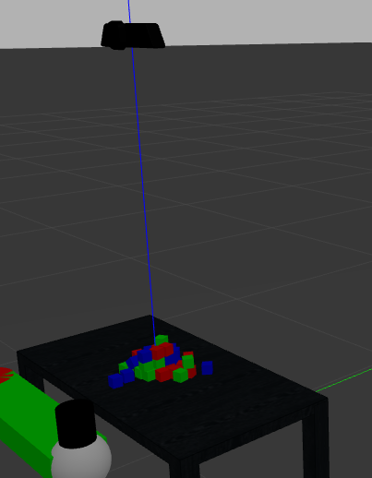
Tracking Level Curves
The image consist of a kinect camera and pile of boxes on the table below it.
This camera will use tracking level curves method to determine the height of the pile.
The robot will use this information to flatten the pile correctly.
Kinect Camera

Slide 7
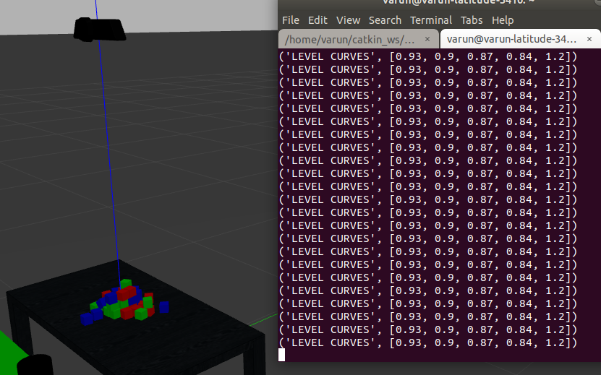
Tracking Level Curves
The image besides shows an example of pile and its tracked level curves.
Level set is a list of values : [0.93,0.9,0.87,0.84,1.2]. As it has 5 values this means level set is of 5 level curves.
Here 1.2 represents ground plane, 0.93 represents table and 0.9,0.87,0.84 represent the levels of piles respectively.
There is a difference of 0.03m in the levels of pile because the height of box is 0.03m
Level curves

Slide 8
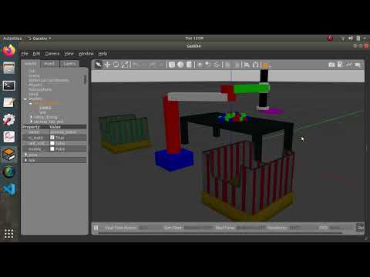
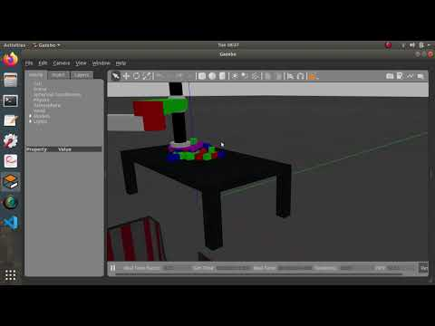
Performance of Caging Gripper
Cutting the level curves step by step
Directly cutting the complete level set

Slide 9

Performance of Gripper with cage
Observations:
-The robot was able to successfully flatten the pile.
-The robot stopped successfully after the pile had flattened. This means it tracked level curves correctly.
- Cutting the level set directly saves time
- The Robot flattened the pile neatly without colliding with the table. It was quite accurate.
The minimum execution time was around 12 secs after robot had arrived to sorting location.

Slide 10
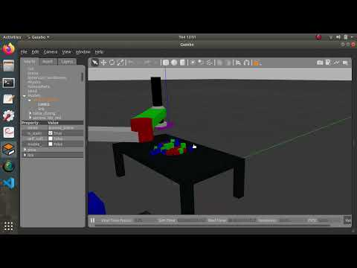
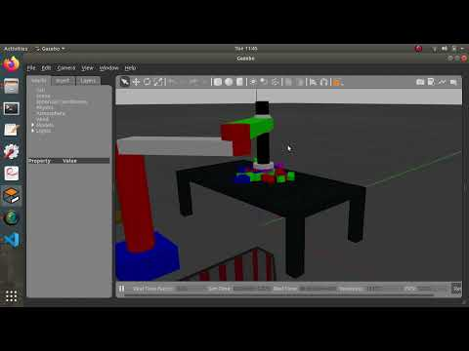
Performance of gripper without cage
Cutting the level curves step by step
Directly cutting the complete level set

Slide 11
Performance of Gripper without Cage
Observations:
-The robot was able to successfully flatten the pile.
-The robot stopped successfully after the pile had flattened. This means it tracked level curves correctly.
- Cutting the level set directly saves time
- The Robot flattened the pile neatly without colliding with the table. It was quite accurate.
The minimum execution time was around 16 secs after robot had arrived to sorting location.

Slide 12

Performance Comparison
The outcome of using gripper with cage and gripper without cage is nearly same. Both are successful in flattening the pile.
The gripper with cage has less execution time compared to gripper without cage. This difference of execution time is around 4 secs.
The flattening is little more neater for gripper with cage than gripper without cage.(packages fall off the table when using gripper without cage)
In a complete level set slicing the gripper with cage flattened the pile in one go however with the gripper without one had to perform two tries as some boxes escaped the pushing trajectory of the gripper. So we can say the gripper with cage is more accurate and can level curve slicing little more accurately.

Slide 13

Conclusion
Both grippers are successfully able to flatten the pile.
If time is a constraint then gripper with cage can perform slightly better than the other one.
Also, gripper with cage performs level curve slicing little better than gripper without cage as it doesn’t let boxes out of its pushing area quite easily.

